Slide 1
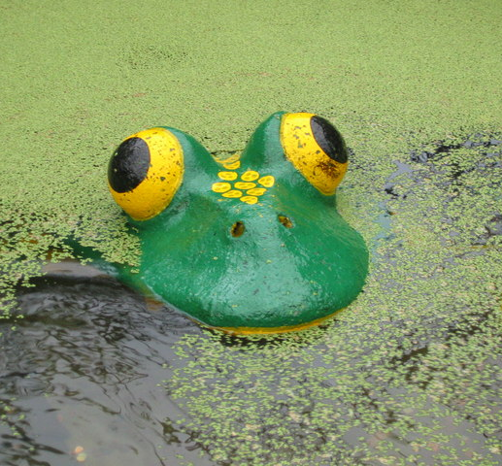
Mcpuddock development
Oleg
Jake
Luca
Clara

Slide 2
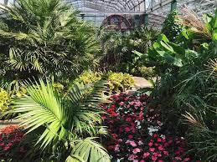
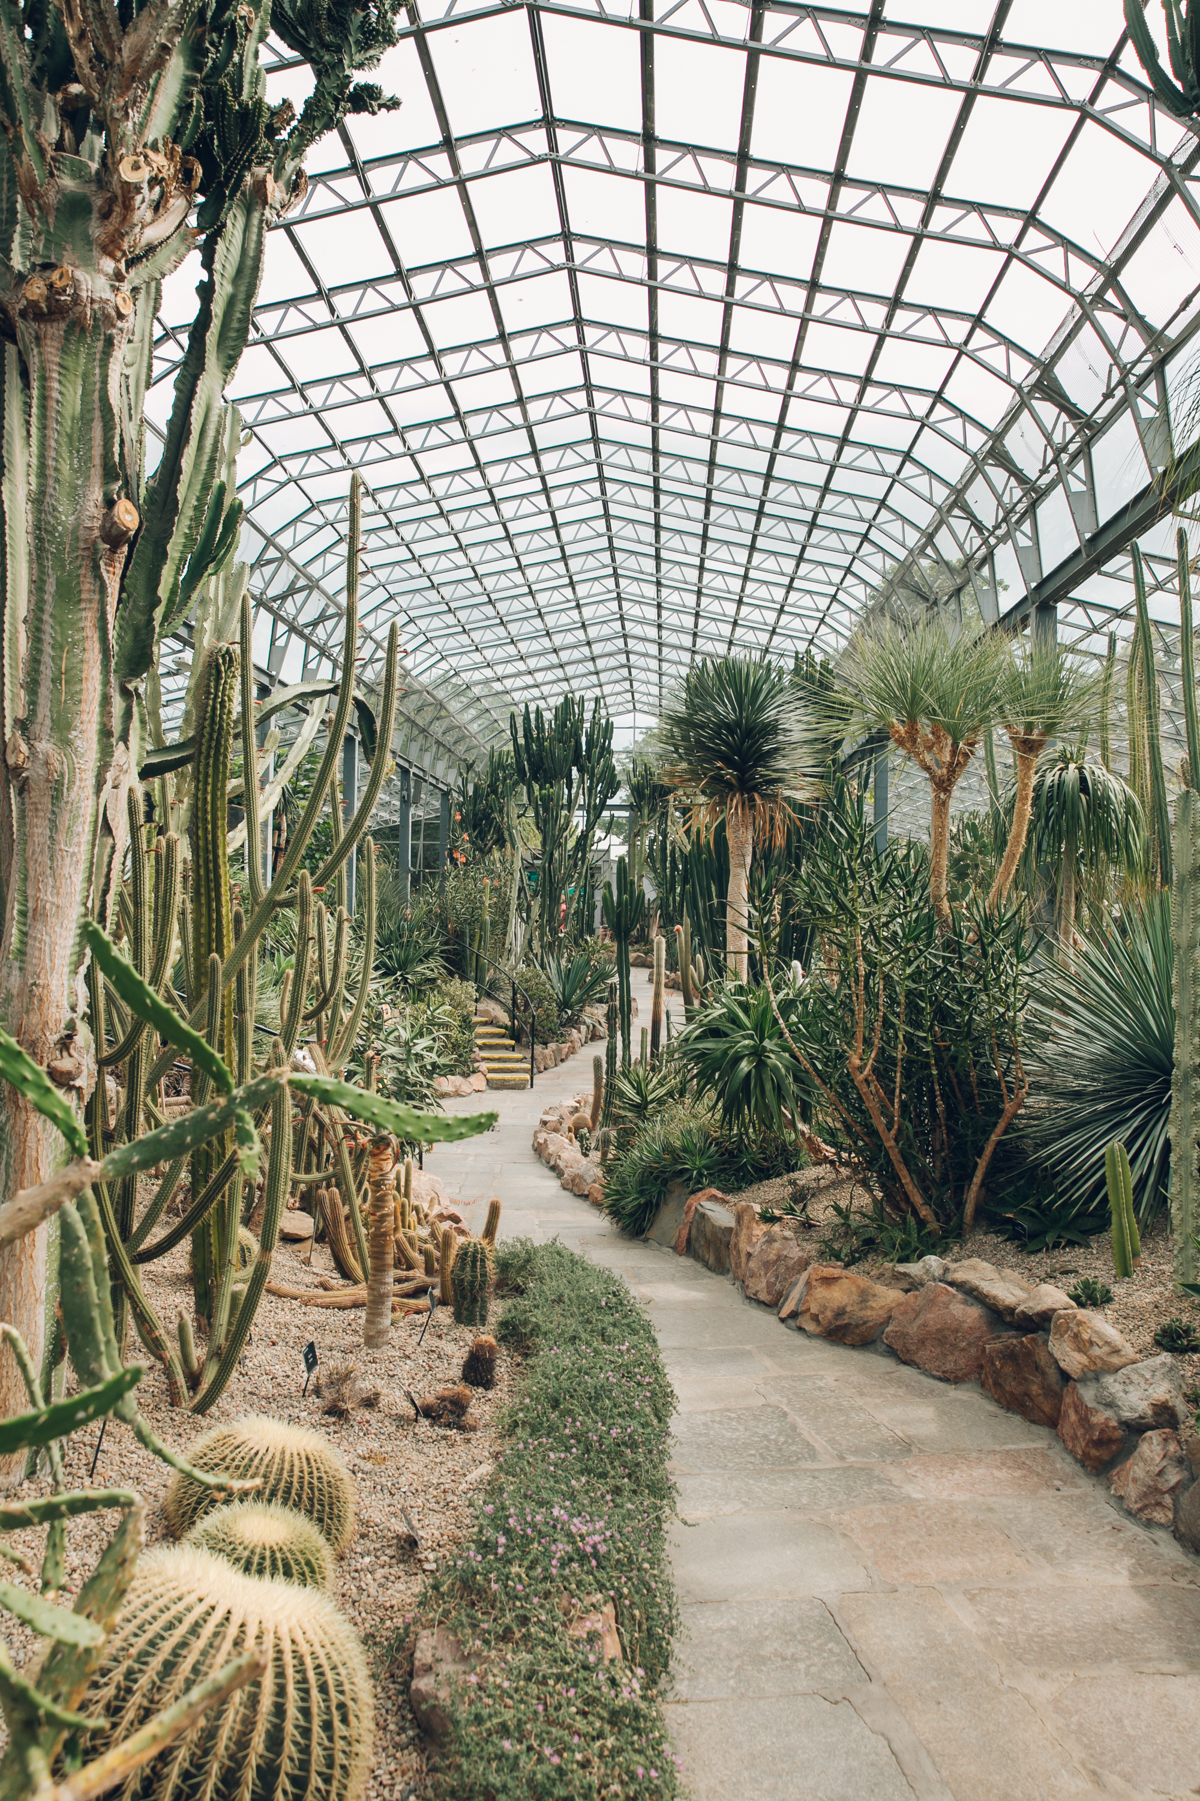
AGENDA
Duthie park website
The idea
Final product

Slide 3
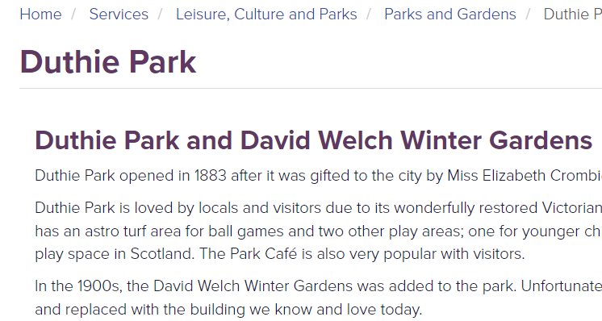
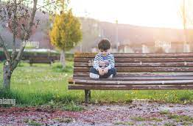
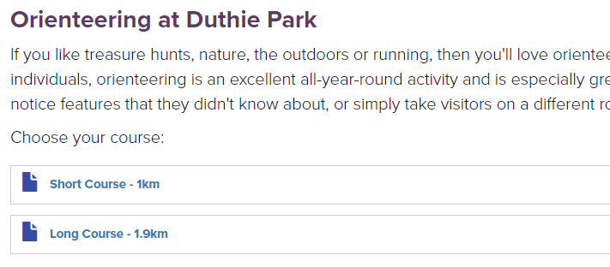
The Current Duthie Park website

Slide 4
Our Aims
Improve layout
Make website interactive
Add security

Slide 5
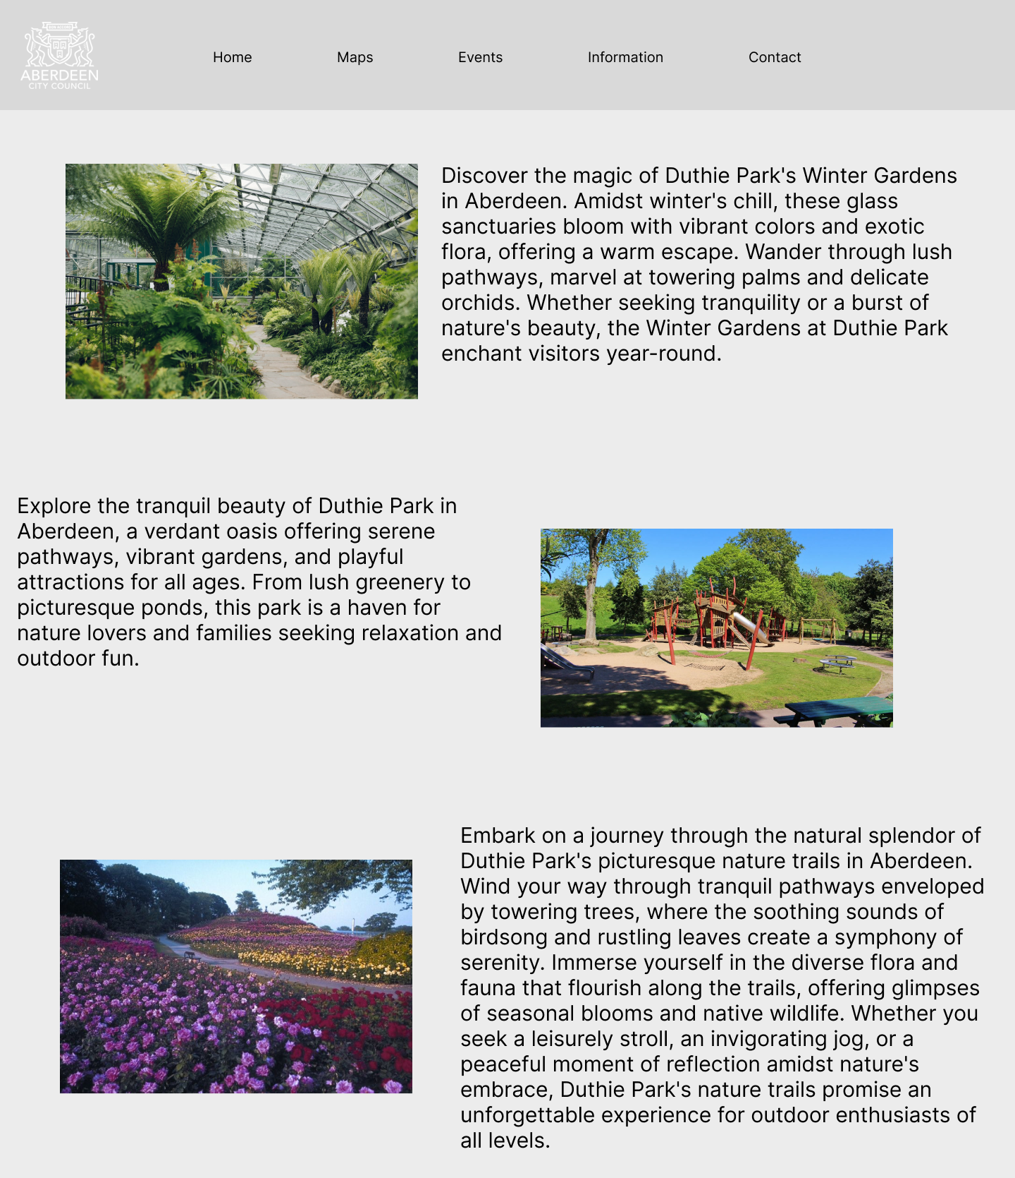
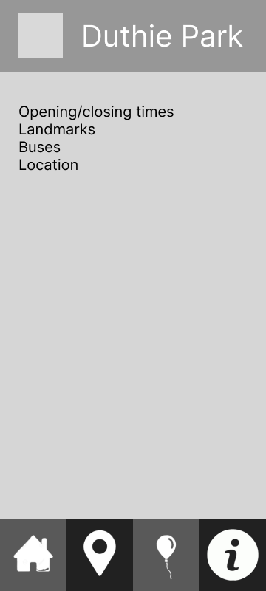
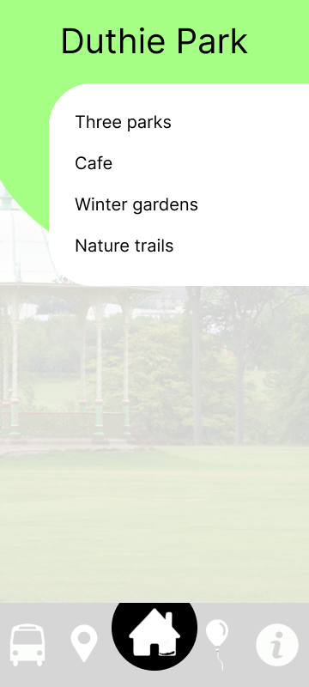
prototyping

Slide 6
Interactable Maps
map markers
Augmented Reality
Click on the markers to view information about each location
Use the camera function to view the world in AR

Slide 7
Website reDesign
html
ejs
css
Add content including text, maps, and images to the website
Used to structure and re-use code blocks for fast prototyping
Website styled the same way as the current one to match the visuals of the Aberdeen council

Slide 8
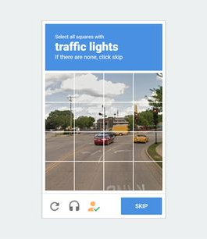
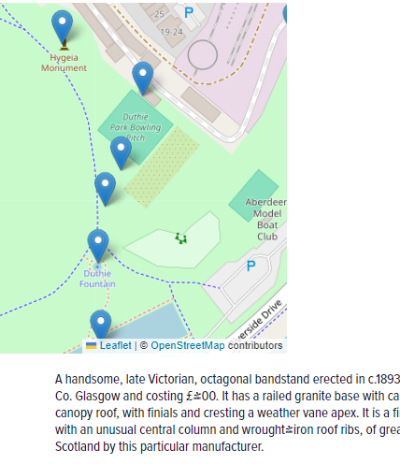
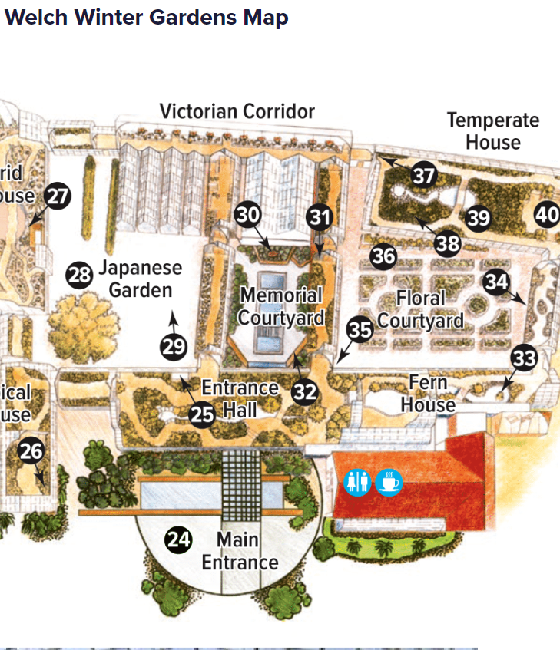
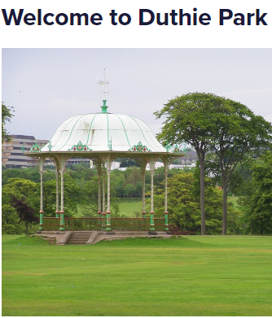
SUMMARY
This new redesign implements html, css, and ejs to create a modern layout that utilizes interactive maps as well as a captcha for security

Slide 9
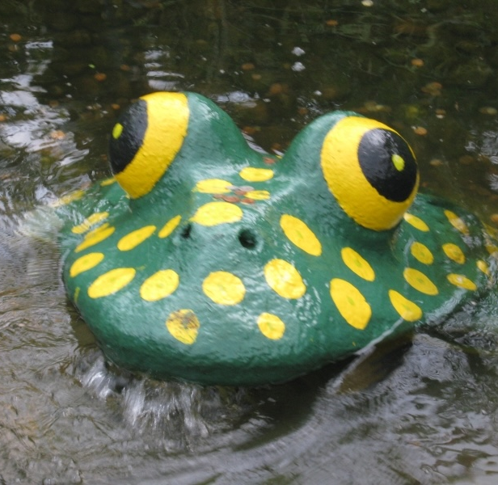
An intuitive and fun design to help navigate Aberdeen’s Duthie Park
McPuddock Development
https://github.com/clararingrose/rguhack2024

